Slide 1


Slide 2
Last Class

Slide 3
Greenwashing
It is an strategy used by companies to maker their products appear environmentally
friendly but in reality they aren’t.

Slide 4
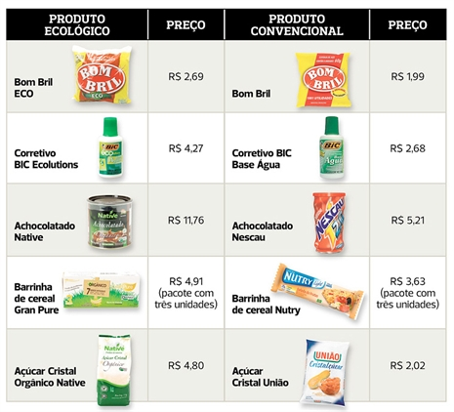

Slide 5
Questions that will help you to improve your talking competence.
What does “blue navy” mean?
How can I say “na verdade isso é um elefante” in English?
How can I pronounce “strategies” correctly?

Slide 6
Cosmopolitan
A place gathering people from many different countries and cultures.
A person familiar with many different countries and cultures.
A cocktail typically made with Vodka, Cointreau, cranberry juice and lime juice

Slide 7
Summarizing.
Essentially
Basically
The bottom line is
In short
In a nutshell
In brief

Slide 8


What does it mean?
Flyers
NGO

Slide 9
Come aboard and help us.
Join our ranks and help us.
Then hop on! You are one of us.
Africa is counting on you!
Be a part of this.

Slide 10
Trying out 2 – TALKING TIME
I have been abducted by Aliens

Slide 11
I tend to think
He must be
He is probably
He can’t be
It seems to me
Exploring 2
Activity 2

Slide 12
Trying out 2 – TALKING TIME
People keep saying you haven’t been yourself recently.
You have been reading all kinds of publications about ETs and UFOs (unidentified flying object).
You’ve been hearing funny noises at night that no one else hears.
You have developed a strong desire to explore strange new words.
Use the expressions from Exploring 2

Slide 13
Next Saturday we are not having classes!
CNA will be closed!
SHOWTIME 1 – 14.09.2013

Slide 14
Grammar Talk 1 – page 28
Possible combinations with verbs in the infinitive form and in the –ing form.

Slide 15
Flyer: Start
Dialog: stop, seem, starting, admit, stop.

Slide 16
Normally followed by!!!!!!
Seem (They seem to like me.) Infinitive
Admit (They admitted lying to you.) -ing
Start (They started to do the job/They started
doing the job.) infinitive or -ing. Same meaning.
Stop (He stopped to eat/He stopped eating.)
infinitive or -ing. Different meaning.

Slide 17
Verbs followed by infinitive: seem, claim, tend
E.g. …people who claim to be stage shy…
Verbs followed by ing: admit, mind, look forward to
E.g. Do you mind helping me out…
Verbs followed by either infinitive or ing (with the same meaning): start, like, love
E.g. I like walking = I like to walk
Verbs followed by either infinitive or ing (with different meaning): stop, try, remember
E.g. I tried making a list ≠ I tried to make a list

Slide 18
Last box – Stop / Try / Remember.
Explain and give one example

Slide 19
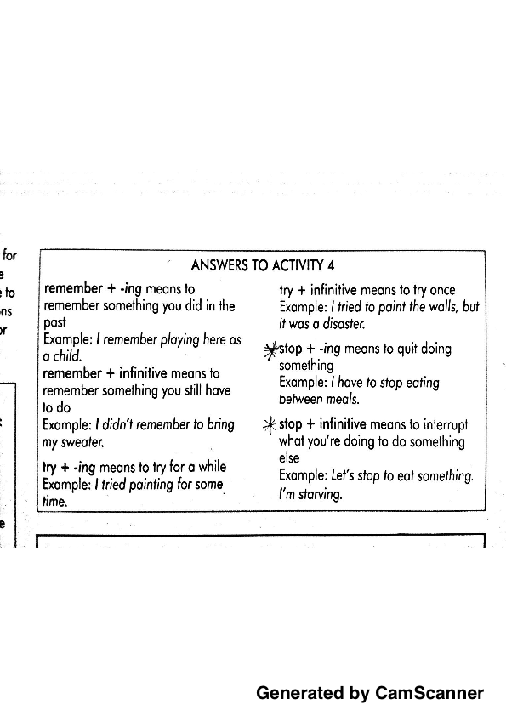

Slide 20
To fund:
Humanitarian:
Not-for-profit:
Volunteer:
Supporter:

Slide 21
To fund: to furnish money for something.
Humanitarian: devoted to the good of humanity.
Not-for-profit: not having the goal of profit.
Volunteer: a person who works for a cause and is not paid for that.
Supporter: someone who contributes to an effort.

Slide 22
Answer to activity 2 Words in Action page 30
Non-governmental organization
Humanitarian or cooperative
Funded
Volunteers
Global
Active
Supporters

Slide 23
In what other contexts may this vocabulary be found?
Discuss with your partner!

Slide 24
Write a short text using those words!

Slide 25
Junior’s presentation!
Summarize the main ideas.
Talk about the context in which it was developed (business, government,
NGO, general public.)
Express your opinion about it.

Slide 26
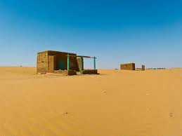
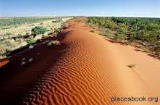
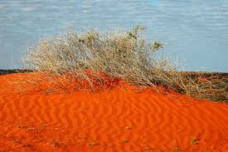
Australian Outback!

Slide 27
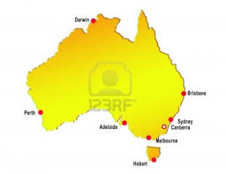

Slide 28
http://www.youtube.com/watch?v=1Tz4dCLrdTA
Royal Flying Doctor Service of Australia (RFDS)

Slide 29
Share your work with friends!

Slide 30
Homework – Incorporating
Summarize the main ideas.
Talk about the context in which it was developed (business, government,
NGO, general public.)
Express your opinion about it.

Slide 31
Different uses of the -ing form.

Slide 32
Activity 1 – Grammar talk 2
4
1
5
3
2

Slide 33
His trying (he did something – TO DEFINE COSMOPOLITAN)
Are growing (Action: TO GROW / Time: INCREASINGLY GLOBAL CONTEXT)
About understanding (About what??? GLOBAL FACTORS - Preposition)
An emerging global community (Emerging as an ADJECTIVE)
Understanding our place in time (PART OF A SUBJECT OUR)

Slide 34
Activity 2 – Grammar talk 2
DO IT AS A HOMEWORK

Slide 35
Bolivia demands Brazil return fugitive senator
The president of Bolivia has demanded Brazil ‘return’ fugitive opposition senator Ricardo Pinto, who was smuggled out of Bolivia in a Brazilian embassy vehicle at the weekend.
Mr. Pinto should be extradited back to Bolivia.
Mr. Pinto shouldn’t be extradited back to Bolivia.
Arguments!

Slide 36
END
AND
Sound Spot

Slide 37
END - 2
AND - 1
Sound Spot

Slide 38
http://www.youtube.com/watch?v=GaiXKyog5xE
Man and Men sound

Slide 39
Sound Spot
Listen and repeat!

Slide 40
Sound Spot
Ten (e)
Bat (ae)
Said (e)
Gas (ae)
Dead (e)
Bad (ae)

Slide 41
Sound Spot
Ten (e)
Bat (ae)
Said (e)
Gas (ae)
Dead (e)
Bad (ae)
Tan (ae)
Bet (e)
Sad (ae)
Guess (e)
Dad (ae)
Bed (e)

Slide 42
Sound Spot
Practice the mini-dialogs!

Slide 43
Their lives have been affected by global or international events.

Slide 44
My life makes total sense. / We are happily living together.
Now I feel my life makes total sense.
Meeting Mergen was the bonus of a life time.
It’s like we are all part of the big family.
Both changed their lives because of events beyond their immediate
environment.

